Slide 1
The design and development of AIRYL

Slide 2

Debayan De
Rohit Das
Rudra Nil Basu
Sumitra Chowdhury
BitCoders
http://phoenixrrds.github.io/

Slide 3
What is AIRYL?

Slide 4

What is AIRYL?
A chatbot based on AIML
Based on Android
Fully documented using Sphinx
Open Sourced
Under MIT License
github.com/PhoenixRRDS/AIRYL

Slide 5
DEMO

Slide 6
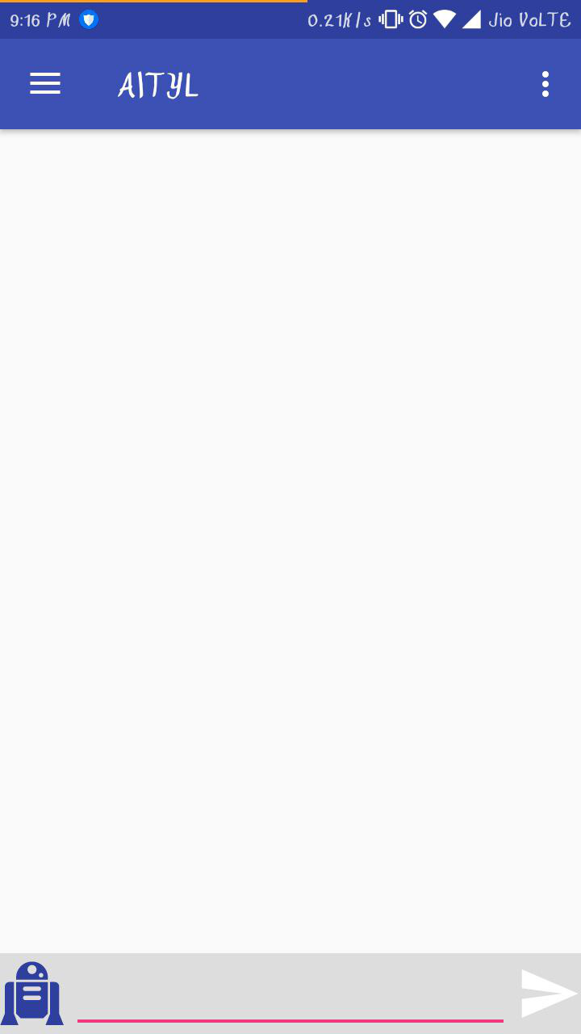
DEMO

Slide 7
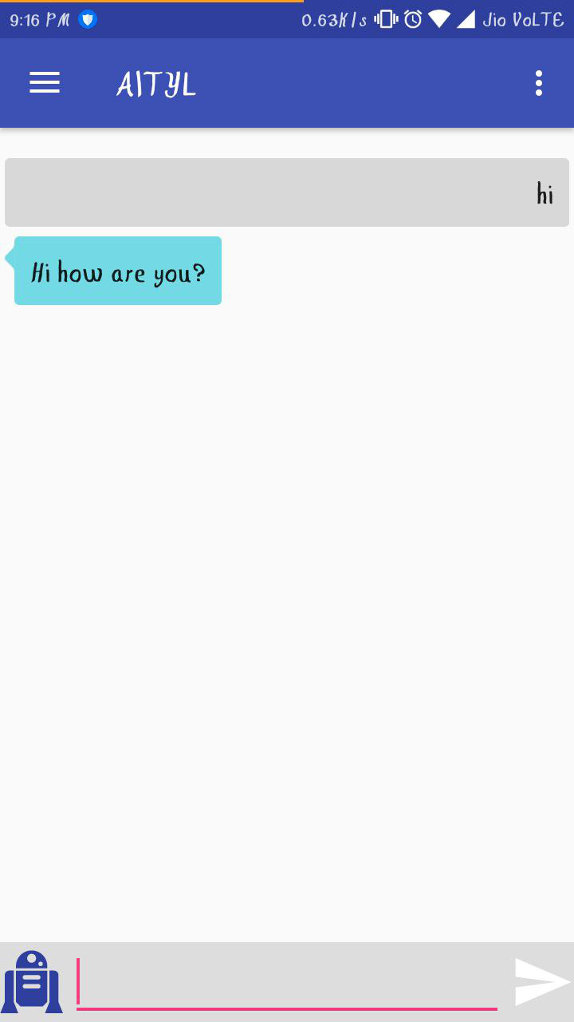
DEMO

Slide 8
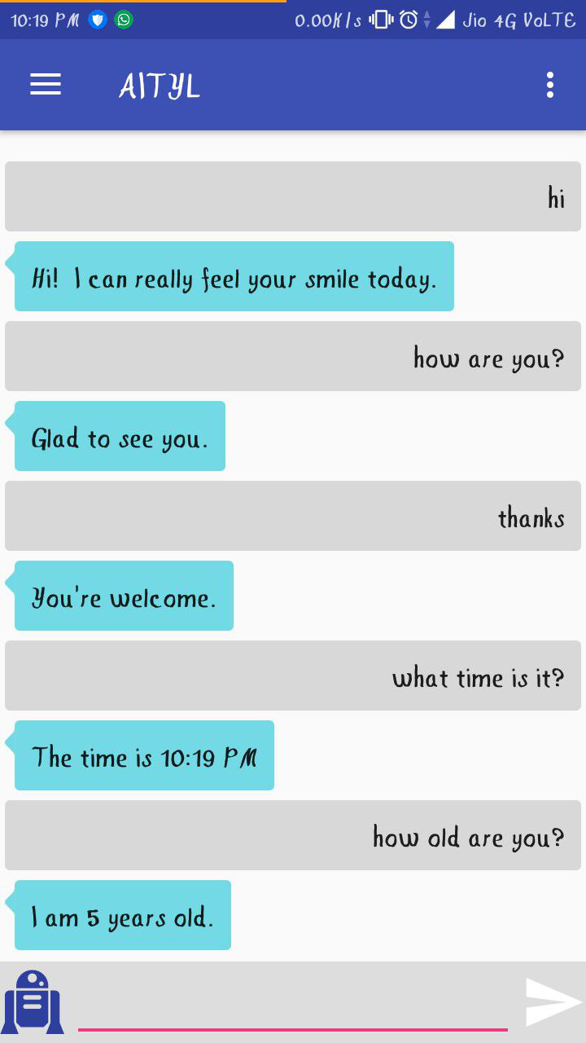
DEMO

Slide 9
ROADMAP
History of AI Debayan De
Alicebot and AIML Rohit Das
Android Implementation Rudra Nil Basu
Documentation using Sphinx Sumitra Chowdhury
Development workflow Rudra Nil Basu
Future work
github.com/PhoenixRRDS/AIRYL

Slide 10

1. History of AI
Debayan De
/debayan130

Slide 11
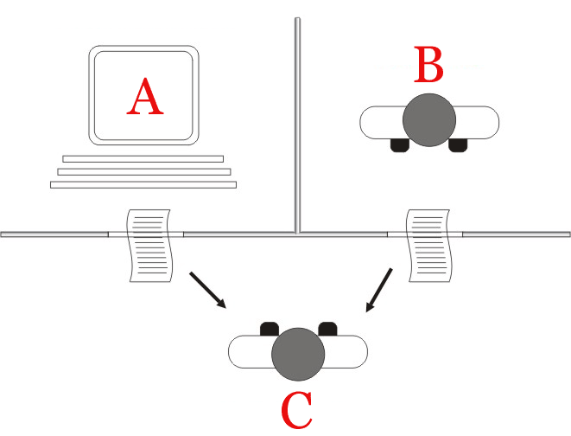
Artificial intelligence
Alan Turing on AI in “Computing Machinery and Intelligence”(1950; p. 460) :-
“I propose to consider the question, 'Can machines think?'"
Turing's new question is: "Are there imaginable digital computers which would do well in the imitation game?" This question, Turing believed, is one that can actually be answered. In the remainder of the paper, he argued against all the major objections to the proposition that "machines can think".
An era for Artificial Intelligence was born.

Slide 12
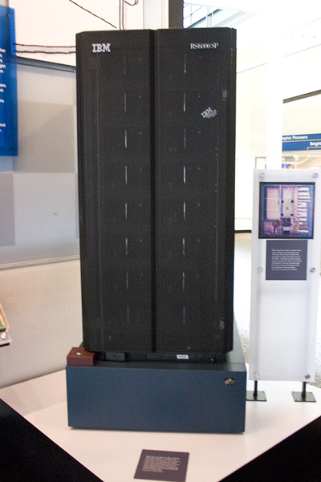


Machine beats man
World Chess Champion Gary Kasparov
(1985 – 93 undisputed, Grandmaster 1980).
IBM Supercomputer Deep Blue
(120 MHz, written in C, AIX OS, 200 Mil positions per sec.)
1996 – Deep Blue wins 4-2
1997 – Deep Blue wins 3$1/2$ – 2 $1/2$

Slide 13
2. Alicebot and AIML
Rohit Das
/mouri11

Slide 14



Android and A. L. I. C. E.
AITYL
AIRYL (AI Reads Your Letters) is an amalgam of the finesse and flexibility of the Android platform and the prowess and versatility of A. L. I. C. E.
AIML (Artificial Intelligence Markup Language) is used in
A. L. I. C. E.

Slide 15
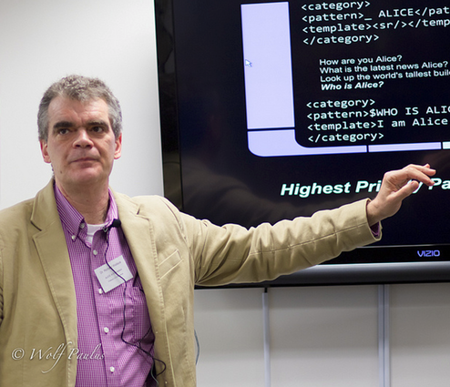
What is A. L. I. C. E. exactly?
A. L. I. C. E. (short for Artificial Linguistic Intelligence Computer Entity) is an open-source AI bot written in AIML, by Richard Wallace between ’95 – ’02.
AIML(Artificial Intelligence Mark-up Language) is an XML dialect.
A. L. I. C. E. can be implemented in any platform
Check it out at <alicebot.org>

Slide 16
A Demo on A. L. I. C. E.

Slide 17
3. Android implementation
Rudra Nil Basu
/RudraNilBasu

Slide 18
3. Android implementation
3.1 The UI

Slide 19
Relative Layout

Slide 20
Relative Layout
Allows child views relative to their parent

Slide 21
Relative Layout
Allows child views relative to their parent
android:layout_alignParentTop
If “true” makes the top edge of this view match the top edge of the parent

Slide 22
Relative Layout
<RelativeLayout
…
android:layout_width: “match_parent”
android:layout_height: “match_parent”
…
</RelativeLayout>

Slide 23
Relative Layout
<RelativeLayout
…
<ListView
…
android:id=“@+id/messageView”
…
/>
…
</RelativeLayout>

Slide 24
Linear Layout
Aligns all child in a single direction

Slide 25
<RelativeLayout
…
<LinearLayout
…
android:orientation: “horizontal”>
…
</LinearLayout />
…
</RelativeLayout>

Slide 26
<RelativeLayout
…
<LinearLayout
…
<EditText
…
/>
<Button
…
/>
…
</LinearLayout />
…
</RelativeLayout>

Slide 27
Result

Slide 28
3. Android implementation
3.2 Sending Messages

Slide 29
3. Android implementation
3.2 Sending Messages

Slide 30
ChatMessage
Message (String)
Sender (String)
Date and time

Slide 31
3. Android implementation
Button.OnClickListener

Slide 32
Button.OnClickListener
void onClick()
{
String message = mEditText.getText().toString();
sendMessage(message);
mEditText.setText(“”);
}

Slide 33
sendMessage(String)
void sendMessage(String message)
{
ChatMessage chatMessage = new ChatMessage(message);
mAdapter.add(chatMessage);
// respond to “message”
}

Slide 34
Bot response
Bot bot = new Bot();
String response = bot.multiSentenceResponse(message);

Slide 35
Bot response
ChatMessage chatMessage = new ChatMessage(response);
mAdapter.add(chatMessage);

Slide 36
Chat History
Storing ChatMessage Adapter in a File
Use a database

Slide 37
4. Documentation using Sphinx
Sumitra Chowdhury
/RudraNilBasu

Slide 38
Importance of documentation
For developer :
Keeps track of the how and what of the development process.
Provides the contributing guidelines and environment setup for the project .
For user :
To know about the project :
The problems it addresses and the solution it provides
Future scope of the project
Release details

Slide 39

Sphinx is a tool that makes it easy to create intelligent and beautiful documentation.
Features
Sphinx converts reStructuredText (.rst) files into HTML(for web) and LaTex(for printable pdf) formats.
Semantic markup and code highlighting
Easy definition of a document tree, with automatic links to siblings, parents and children

Slide 40
How it works
Get started with $ sphinx-quickstart
This creates a source directory with a default conf.py with the configuration values and an index.rst file.
The main function of index.rst is to serve as a welcome page and to contain the root of the table of contents tree (toctree). Using this tree Sphinx adds multiple .rst files to a single hierarchy of documents.
Add content using the reStructuredText markup.
Build the documentation using
$ make html (for web version)
$ make latexpdf (for pdf)

Slide 42
5. Development Workflow
Rudra Nil Basu
/RudraNilBasu

Slide 43
Git

Slide 44
Patches
airyl@googlegroups.com

Slide 46
Git Log

Slide 47
Git Blame

Slide 48
GitHub
github.com/PhoenixRRDS/AIRYL

Slide 49
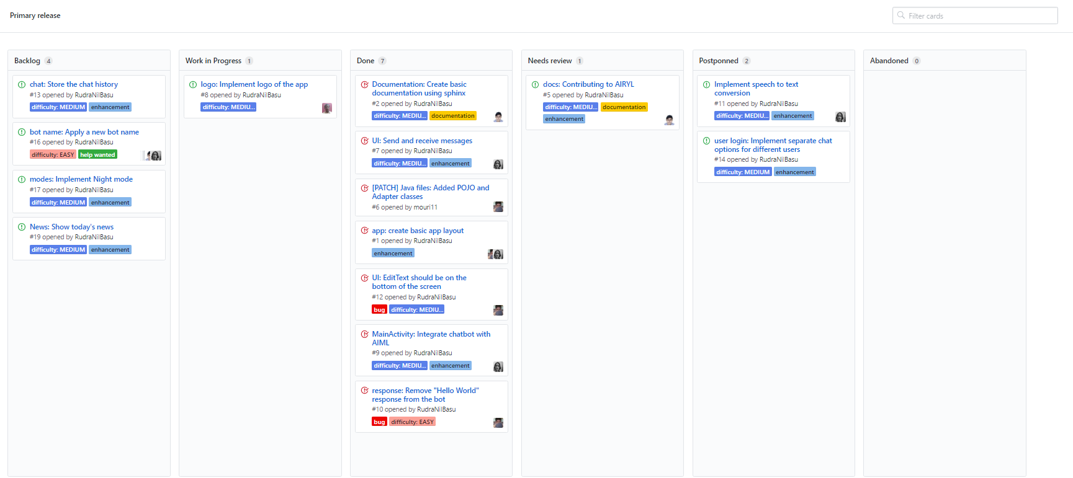
GitHub
github.com/PhoenixRRDS/AIRYL

Slide 50
Future Work
Speech to text conversion
User Login
Night mode
Store user’s notes, display current day’s News
github.com/PhoenixRRDS/AIRYL

Slide 51
QUESTIONS?

Slide 52
Thank You
Debayan De
Rohit Das
Rudra Nil Basu
Sumitra Chowdhury
BitCoders
http://phoenixrrds.github.io/

